Slide 1
Swiggy Data Analysis
Deepak Chawde

Slide 2
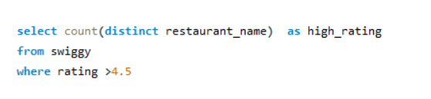

-- HOW MANY RESTAURANTS HAVE A RATING GREATER THAN 4.5?

Slide 3
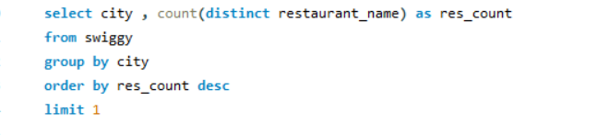
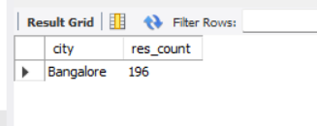
-- WHICH IS THE TOP 1 CITY WITH THE HIGHEST NUMBER OF RESTAURANTS?

Slide 4
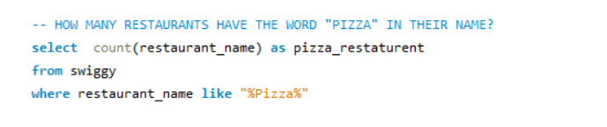

-- HOW MANY RESTAURANTS HAVE THE WORD "PIZZA" IN THEIR NAME?

Slide 5
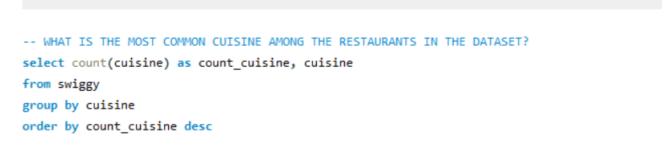
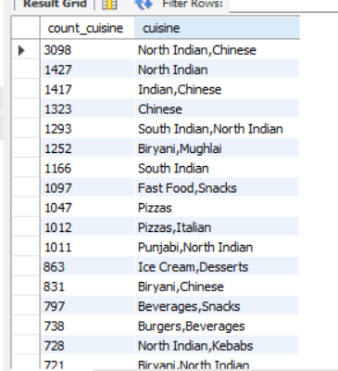
-- WHAT IS THE MOST COMMON CUISINE AMONG THE RESTAURANTS IN THE DATASET?

Slide 6
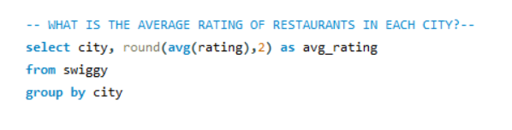
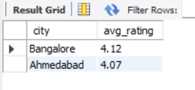
-- WHAT IS THE AVERAGE RATING OF RESTAURANTS IN EACH CITY?--

Slide 7
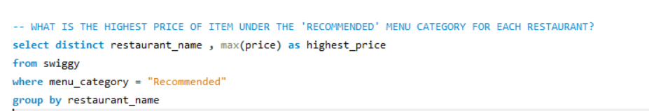
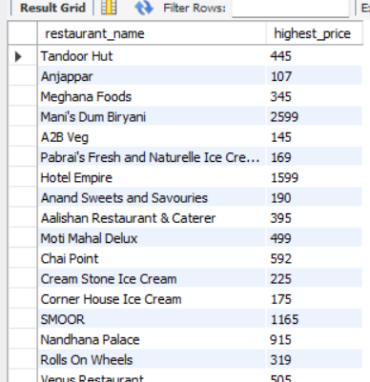
-- WHAT IS THE HIGHEST PRICE OF ITEM UNDER THE 'RECOMMENDED' MENU CATEGORY FOR EACH RESTAURANT?

Slide 8
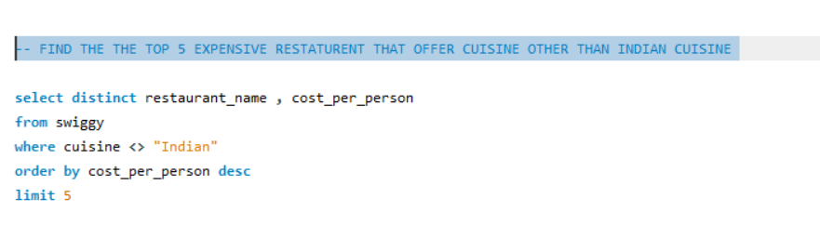
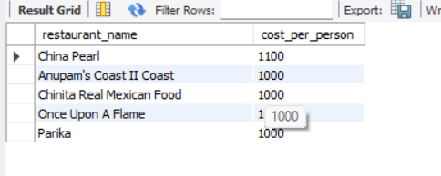
-- FIND THE THE TOP 5 EXPENSIVE RESTATURENT THAT OFFER CUISINE OTHER THAN INDIAN CUISINE

Slide 9
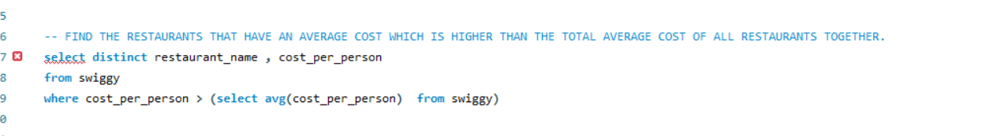
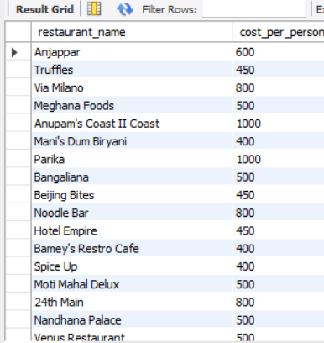
-- FIND THE RESTAURANTS THAT HAVE AN AVERAGE COST WHICH IS HIGHER THAN THE TOTAL AVERAGE COST OF ALL RESTAURANTS TOGETHER.

Slide 10
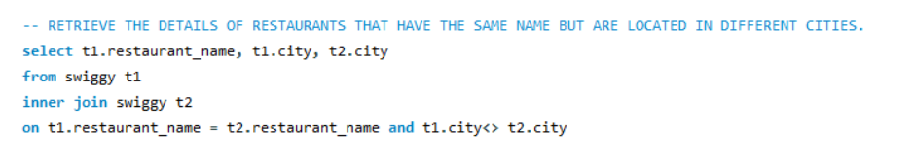
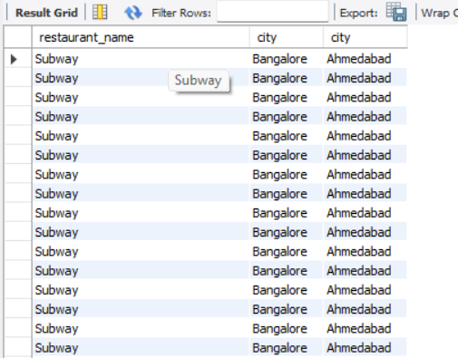
-- RETRIEVE THE DETAILS OF RESTAURANTS THAT HAVE THE SAME NAME BUT ARE LOCATED IN DIFFERENT CITIES.

Slide 11
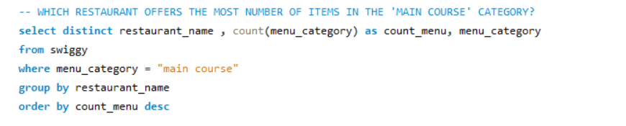
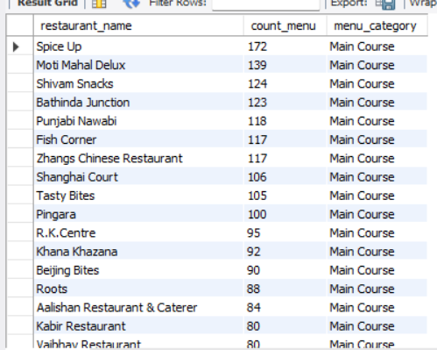
-- WHICH RESTAURANT OFFERS THE MOST NUMBER OF ITEMS IN THE 'MAIN COURSE' CATEGORY?

Slide 12
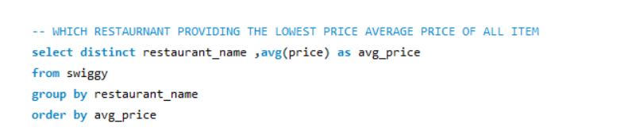
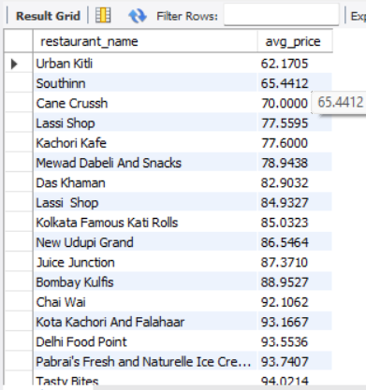
-- WHICH RESTAURNANT PROVIDING THE LOWEST PRICE AVERAGE PRICE OF ALL ITEM

Slide 13
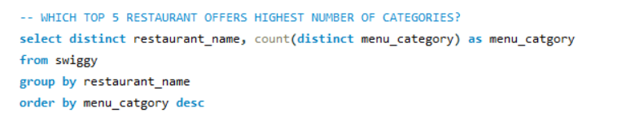
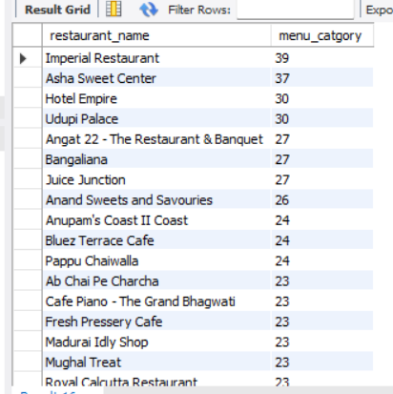
-- WHICH TOP 5 RESTAURANT OFFERS HIGHEST NUMBER OF CATEGORIES?

Slide 14
THANK You

